Slide 1

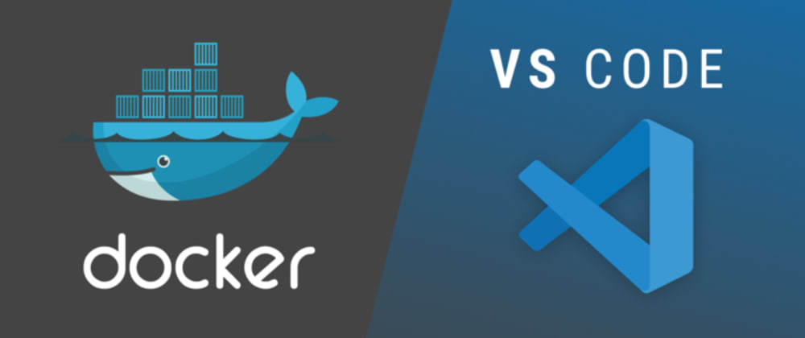
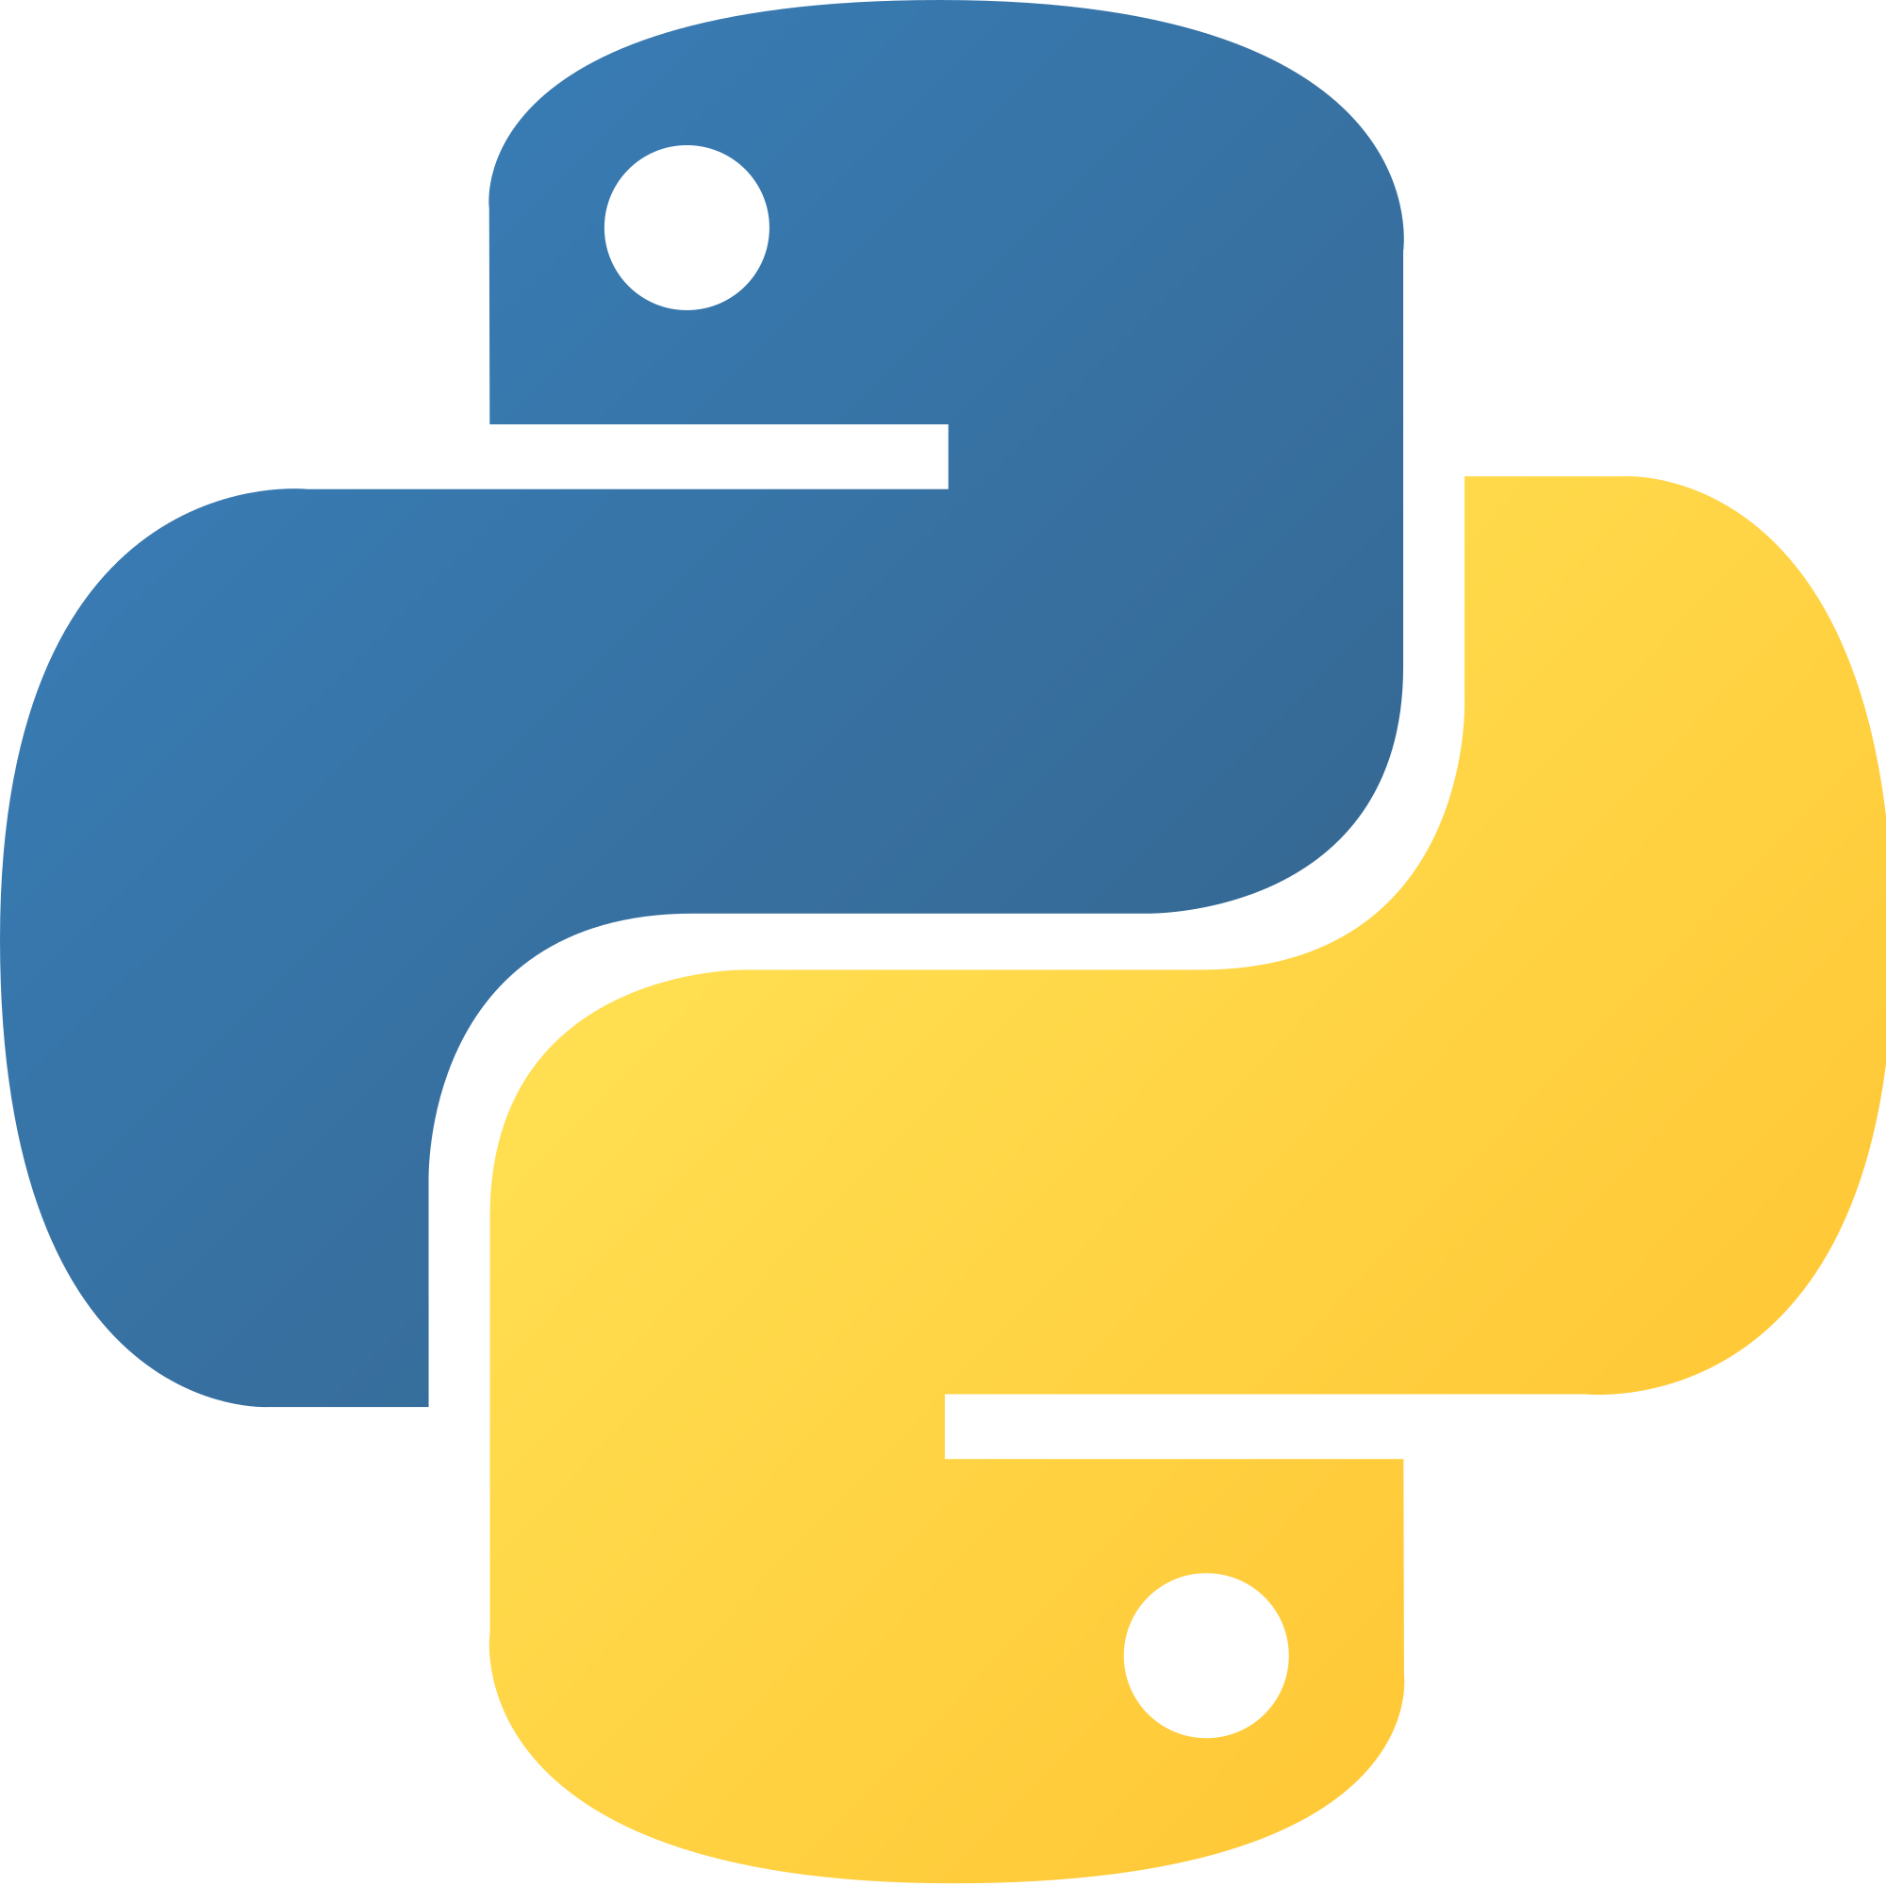

VS Code and DevContainer for Data Scientiest
Codespaces
python

Slide 2
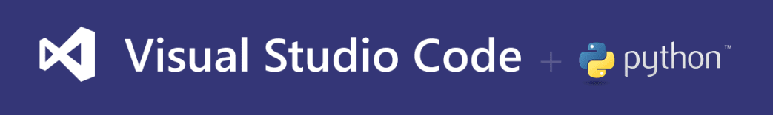
Notes:
https://code.visualstudio.com/docs/languages/Python
https://marketplace.visualstudio.com/items?itemName=ms-python.python

Slide 3
Create and set a Project (settings.json)
Debug (launch.json)
Jupyter Notebook
PyTorch
Notes:
https://code.visualstudio.com/docs/python/python-tutorial
https://code.visualstudio.com/docs/python/settings-reference
https://code.visualstudio.com/docs/python/debugging
https://code.visualstudio.com/docs/datascience/jupyter-notebooks
https://code.visualstudio.com/docs/datascience/pytorch-support

Slide 4


Slide 5
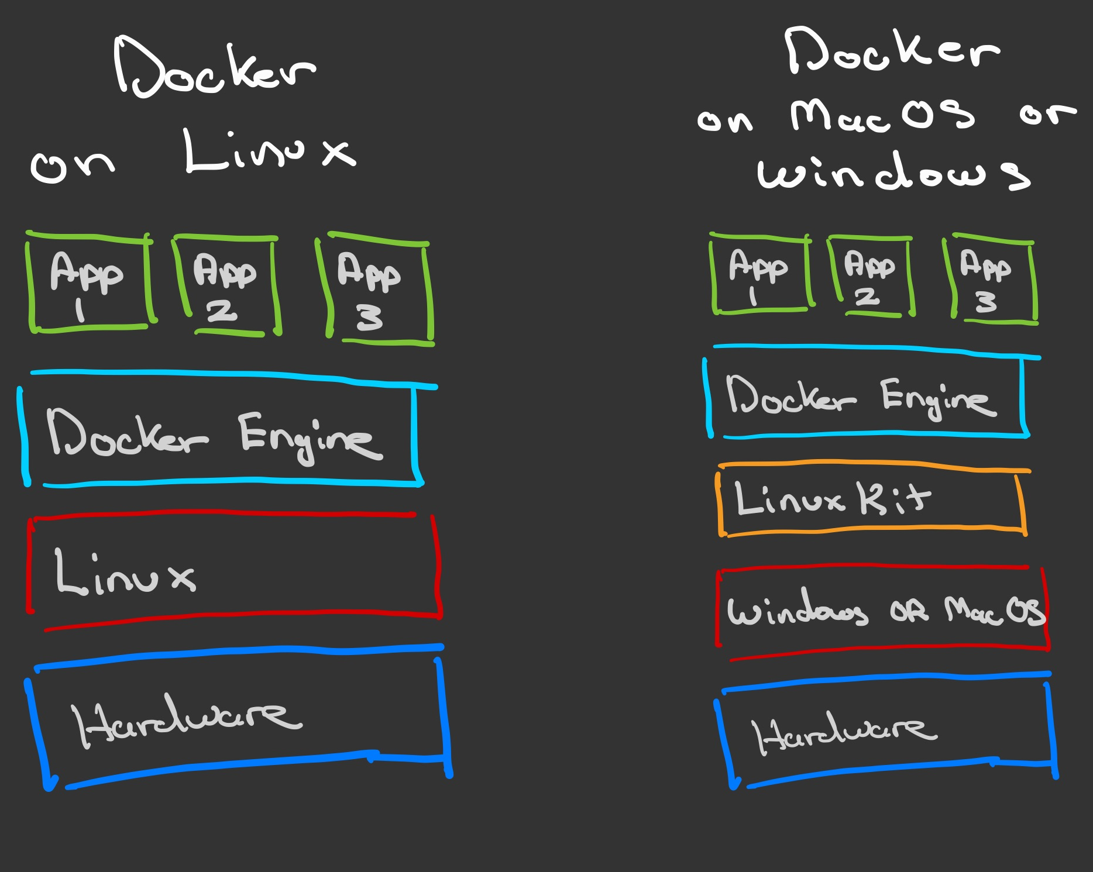
What is Docker?
Notes:
https://www.docker.com/
https://docs.docker.com/get-docker/
https://www.youtube.com/watch?v=_dfLOzuIg2o

Slide 6


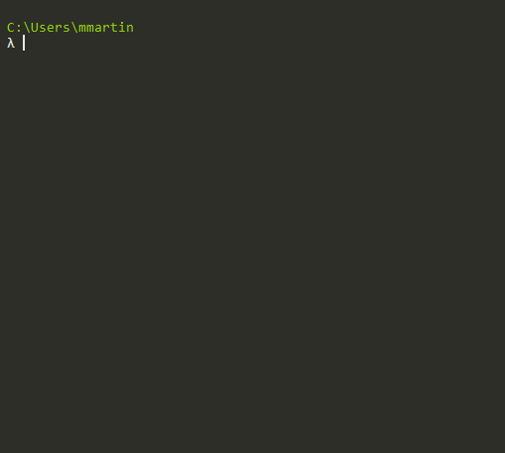
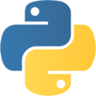
docker concepts
Notes:
https://docs.docker.com/get-started/overview/
https://docs.docker.com/get-started/
https://docs.docker.com/language/python/

Slide 7
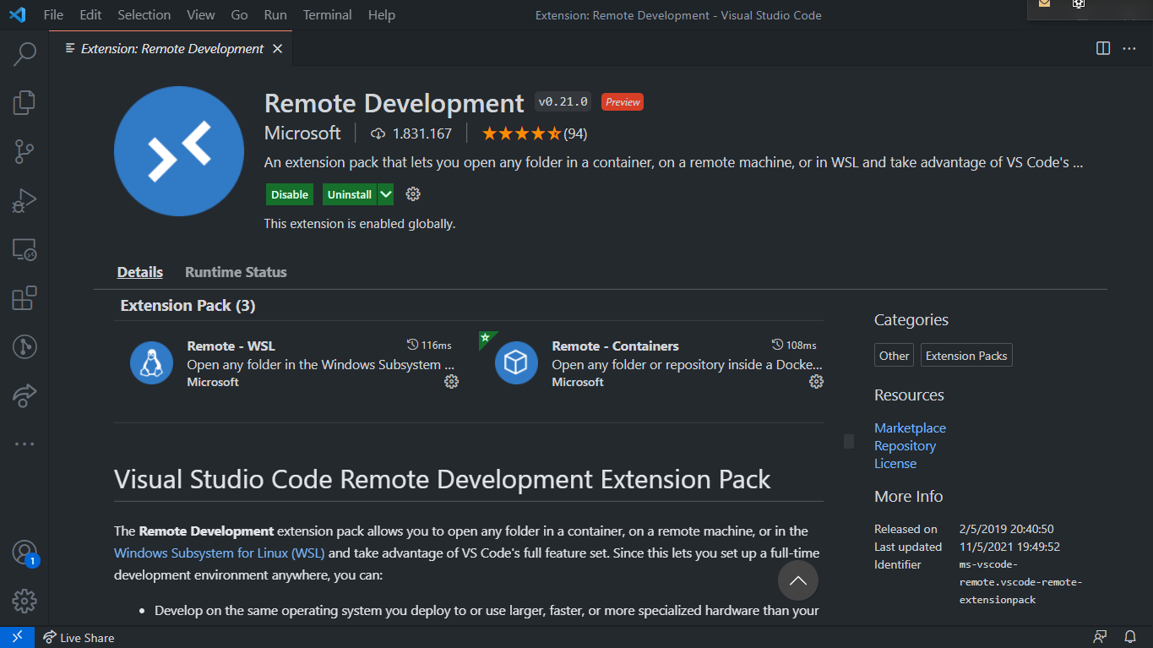
Notes:
https://code.visualstudio.com/docs/remote/remote-overview
https://www.youtube.com/watch?v=sakjpegUQsk

Slide 8
VS Code Remote development
Remote via SSH
Work inWSL
Develop in Containers
Github Codespaces

Slide 9
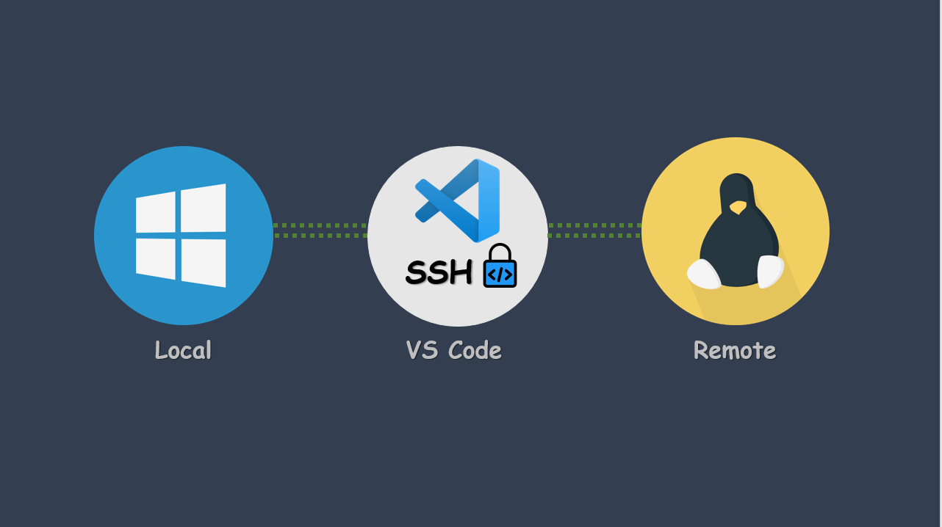
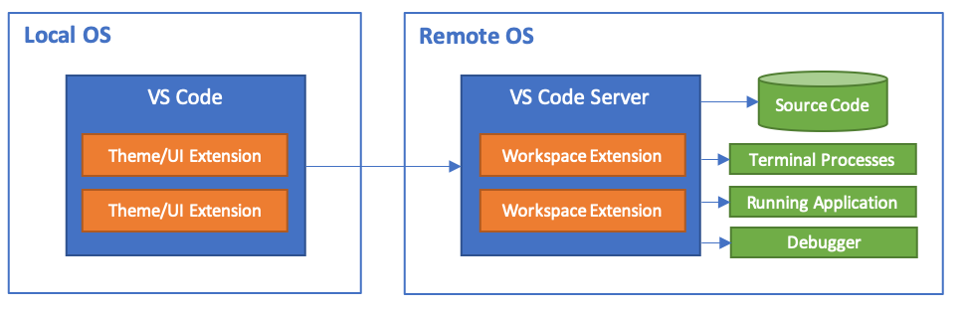
VS Code via SSH
Notes:
https://code.visualstudio.com/docs/remote/ssh

Slide 10
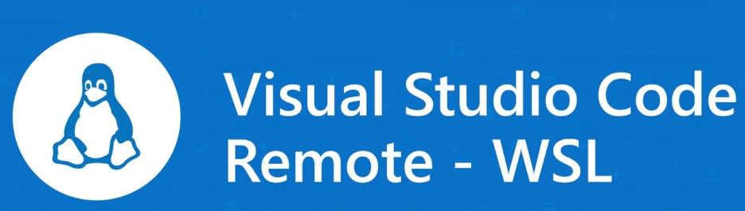
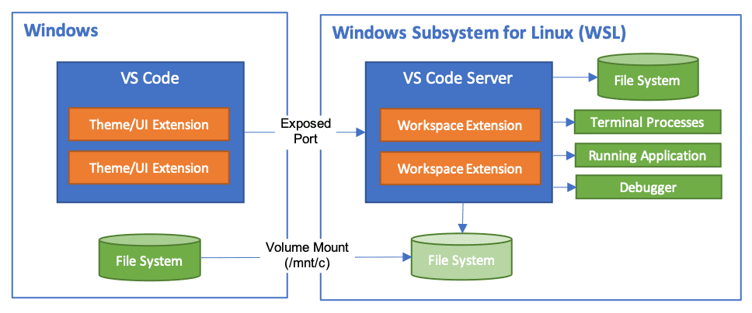
Notes:
https://code.visualstudio.com/docs/remote/wsl

Slide 11
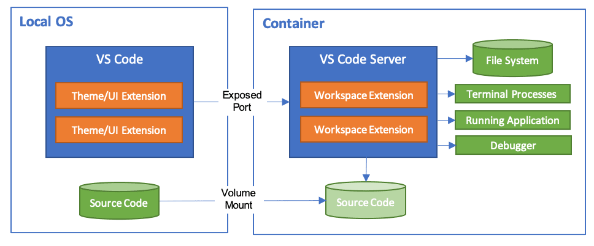
VS Code develop in Containers
Notes:
https://code.visualstudio.com/docs/remote/containers

Slide 12
VS Code develop in Containers
Docker Context my host
DevContainer definition
Running container
Docker Context remote vm
Running container
Notes:
https://code.visualstudio.com/docs/containers/ssh

Slide 13
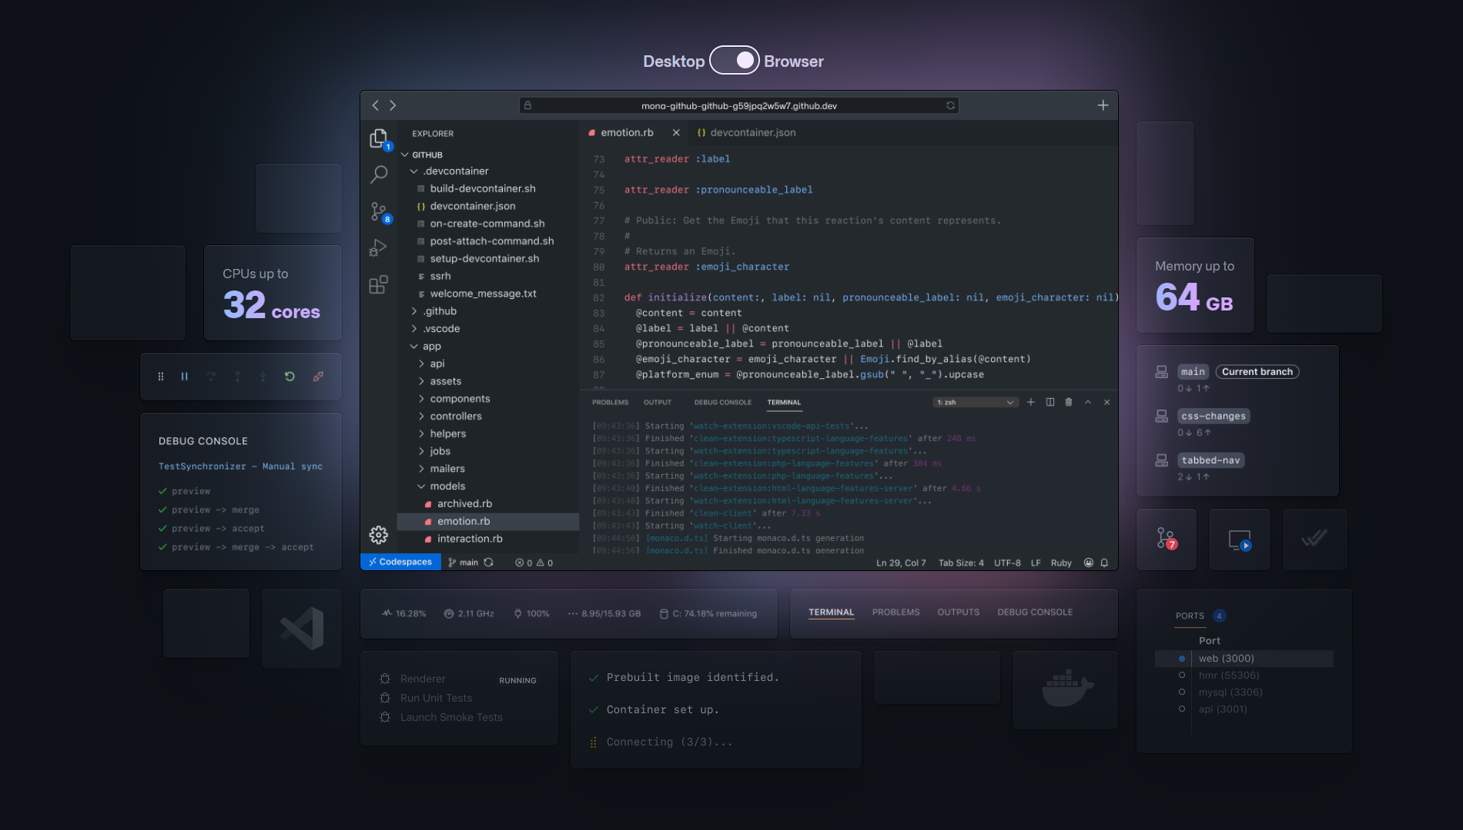
VS Code – GitHub CodeSpaces
Notes:
https://github.com/features/codespaces
https://code.visualstudio.com/docs/remote/codespaces

